Slide 1

Google Wave
Andres Ferrate
Developer Relations
Joe Gregorio
Developer Relations
Dan Peterson
Product Manager

Slide 2
Data API
  Look mom, no robots!

Slide 3
Data API
- Access to waves w/o robots
- OAuth
- Sample: Inbox Checker

Slide 4
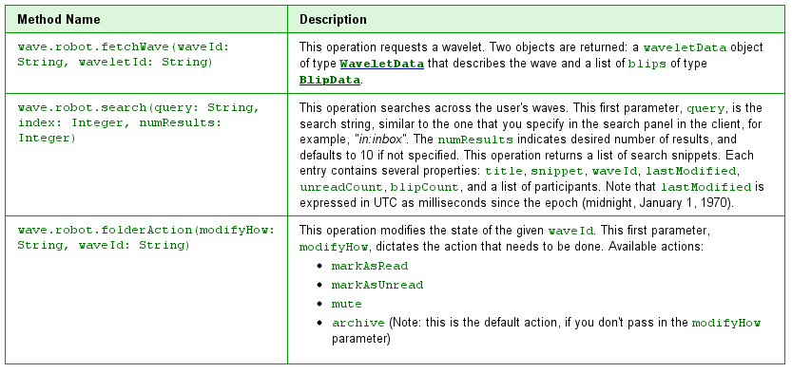
Interface

Slide 5
Test Drive
http://wave-data-api.appspot.com

Slide 6
Thank You
  Questions?

